Slide 1
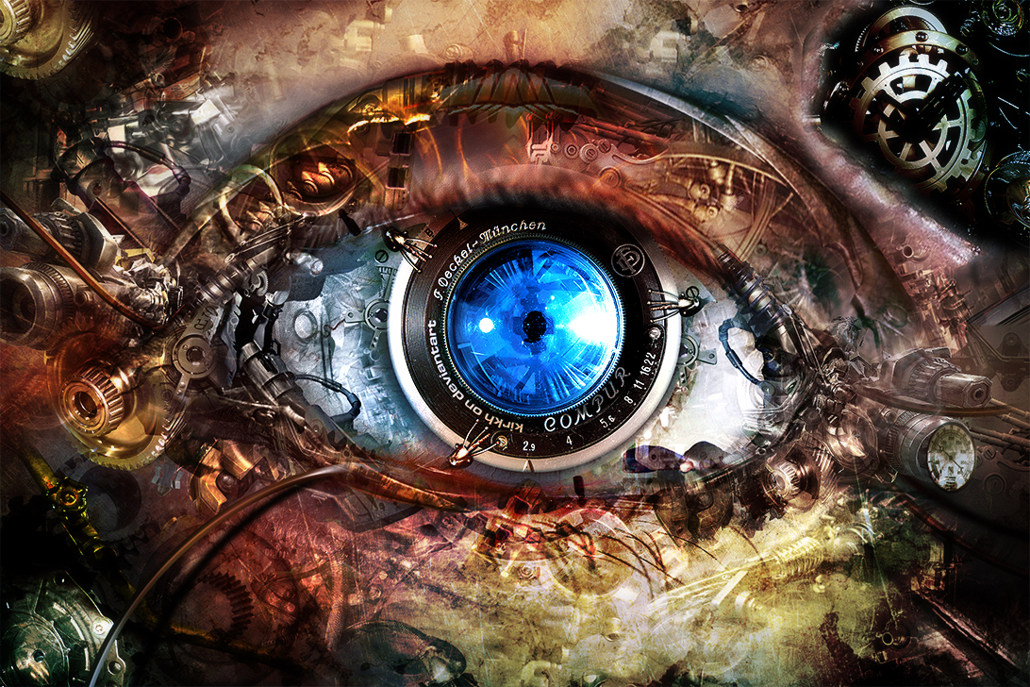
CS 6476: Computer Vision
Instructor: Frank Dellaert Tas: Cusuh Ham (head TA), and 8 (9?) more TAs
Image by kirkh.deviantart.com

Slide 2
Today’s Class
Who am I?
Specifics of this course
What is Computer Vision?

Slide 3
A bit about me
Originally from Belgium
1989 EE in Leuven
1993 M.Sc. ECE at CWRU
2001 Ph.D. CS, Carnegie Mellon
Georgia Tech since August 2001
Teaching Computer Vision etc.:
7641 | Machine Learning | 02, 03, 04 | 45
8803 | 3D Reconstruction and Mapping | 02, 09, 10,12 | 70
4495 | Computer Vision, undergraduate | 04, 05, 06, 07 | 78
8803 | Intro to Perception and Robotics | 05, 06, 07,13,14 | 185
7495 | Computer Vision, graduate | 06, 07, 11, 12, 13 | 153
4475 | Computational Photography | 07, 09, 18 | 155
4480 | Digital Video Special effects | 08, 09, 10, 11 | 146
 |  |  | 832

Slide 5
A bit about me

Slide 6


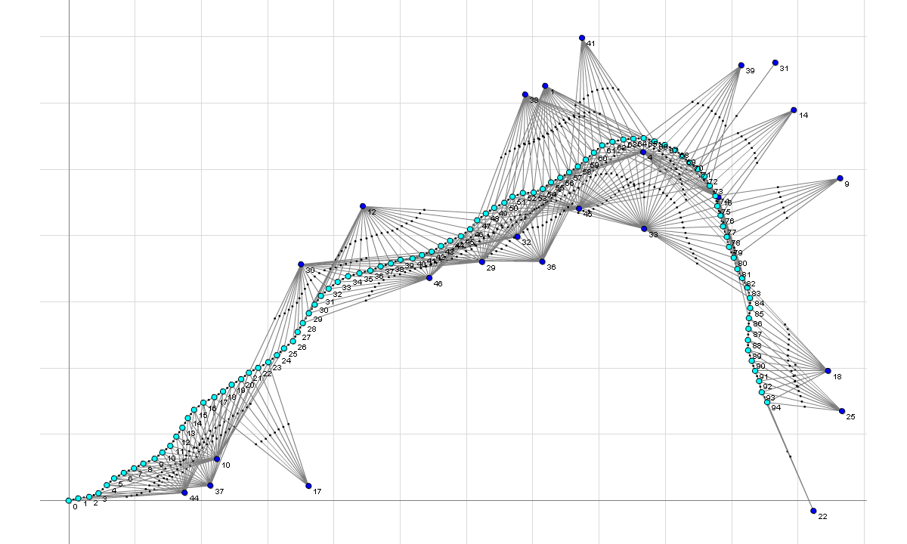
Factor Graphs -> GTSAM !
Factor Graphs and AD for Flexible Inference in Robotics and Computer Vision, © 2008-2018 Frank Dellaert
Notes:
The associated factor graph, as imported in mfqr

Slide 7
Silicon Valley intermission at Skydio

Slide 8

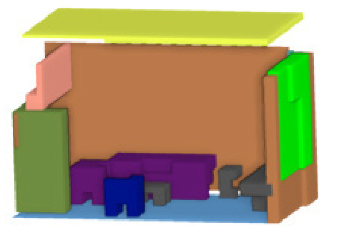
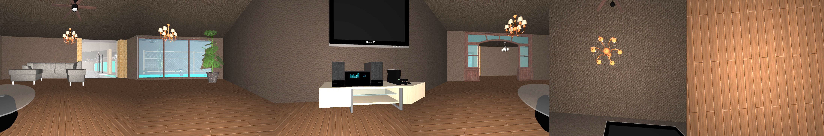

The Scene Understanding and Modeling Challenge
Silicon Valley intermission at Facebook
Color
Depth
RGB-D 360 degree image
Object-based representation of a room
Organizers
Daniel Huber (Facebook)
Lyne Tchapmi (Stanford University)
Frank Dellaert (FB / Georgia Tech)
Vision Problems Addressed
Object segmentation | 6-DOF pose estimation
Object completion | Appearance modeling
Instance labeling | Layout estimation

Slide 9
What’s next? Robot Painting!
For-credit projects available

Slide 10
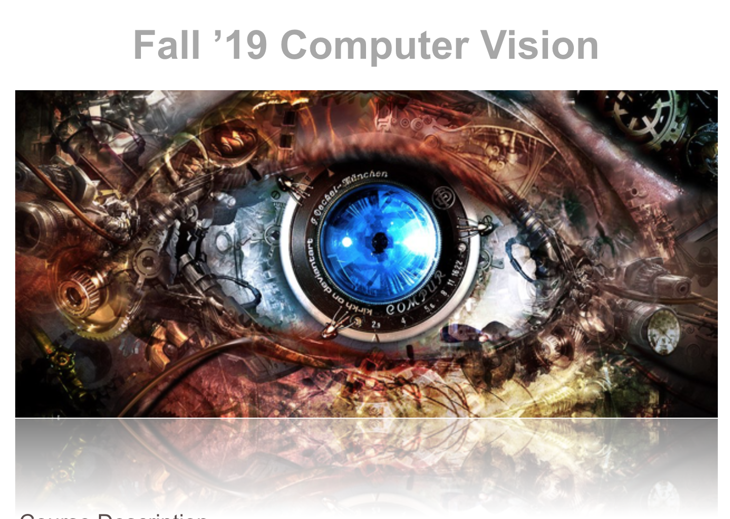
Course Website/Syllabus
tinyurl.com/GT-19F-CS4476
or Google ”Dellaert”

Slide 11
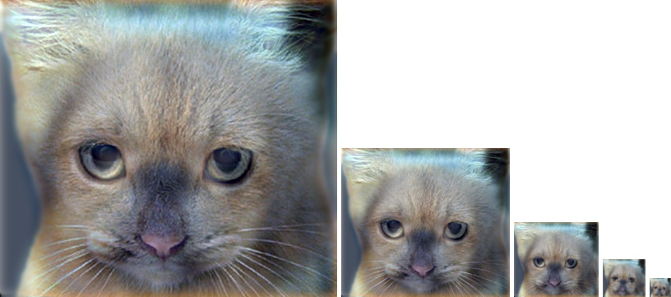
Proj1: Image Filtering and Hybrid Images
Implement image filtering to separate high and low frequencies
Combine high frequencies and low frequencies from different images to create an image with scale-dependent interpretation

Slide 12
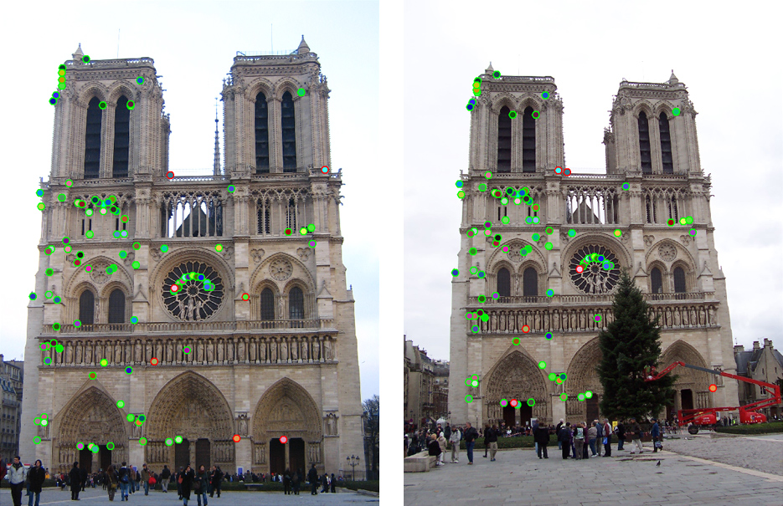
Proj2: Local Feature Matching
Implement interest point detector, SIFT-like local feature descriptor, and simple matching algorithm.

Slide 13
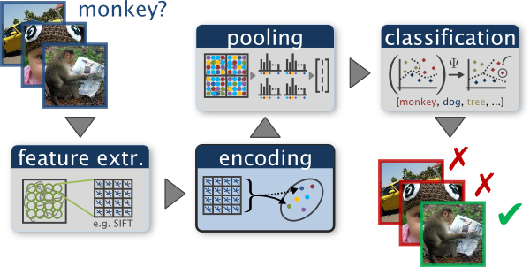
Proj5: Scene Recognition with Bag of Words
Quantize local features into a “vocabulary”, describe images as histograms of “visual words”, train classifiers to recognize scenes based on these histograms.

Slide 14
What is Computer Vision?
Computer Graphics: Models to Images
Comp. Photography: Images to Images
Computer Vision: Images to Models

Slide 15
Scope of CS 4476
Computer Vision
Robotics
Machine Learning
Human Computer Interaction
Image Processing Geometric Reasoning Recognition Deep Learning
Graphics
Medical Imaging
Computational Photography
Neuroscience
Optics

Slide 16
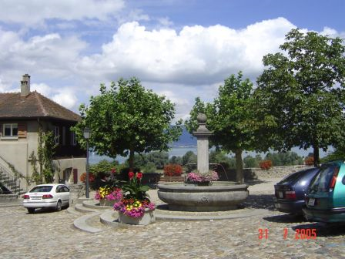
Computer Vision
Make computers understand images and video or any visual data.
What kind of scene?
Where are the cars?
How far is the building?
…

Slide 17
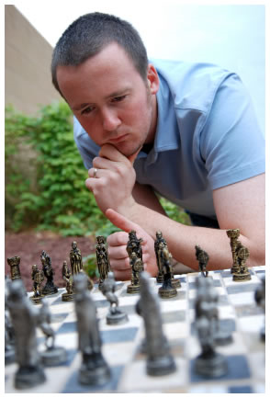
Vision is really hard
Vision is an amazing feat of natural intelligence
Visual cortex occupies about 50% of Macaque brain
One third of human brain devoted to vision (more than anything else)
Is that a queen or a bishop?

Slide 18
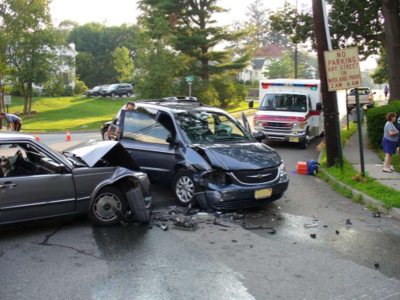
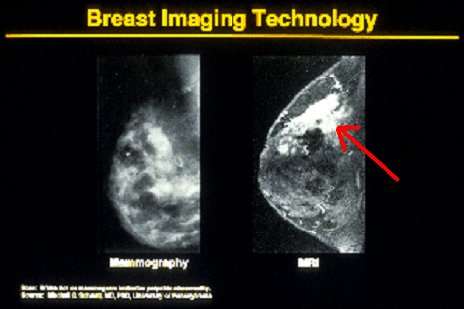
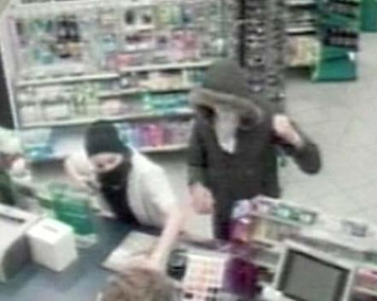
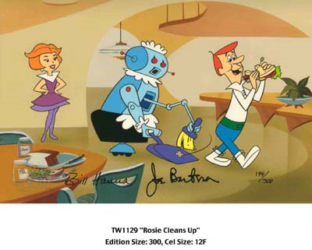
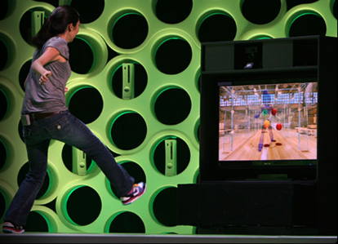
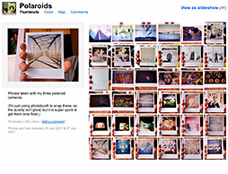
Why computer vision matters
Safety
Health
Security
Comfort
Fun
Access

Slide 19
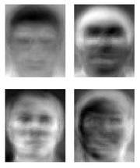
Ridiculously brief history of computer vision
1966: Minsky assigns computer vision as an undergrad summer project
1960’s: interpretation of synthetic worlds
1970’s: some progress on interpreting selected images
1980’s: ANNs come and go; shift toward geometry and increased mathematical rigor
1990’s: face recognition; statistical analysis in vogue
2000’s: broader recognition; large annotated datasets available; video processing starts
2010’s: Deep learning with ConvNets
2020’s: Widespread autonomous vehicles?
2030’s: robot uprising?
Guzman ‘68
Ohta Kanade ‘78
Turk and Pentland ‘91

Slide 20
How vision is used now
Examples of real world applications
Some of the following slides by Steve Seitz

Slide 21
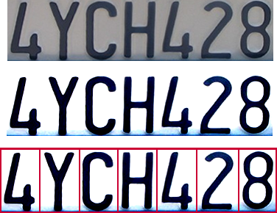

Optical character recognition (OCR)
Technology to convert scanned docs to text
If you have a scanner, it probably came with OCR software
Digit recognition, AT&T labs
http://www.research.att.com/~yann/
License plate readers
http://en.wikipedia.org/wiki/Automatic_number_plate_recognition

Slide 22
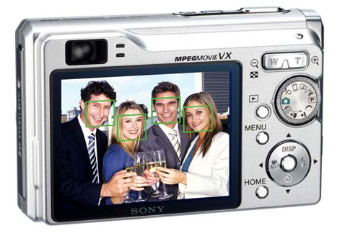
Face detection
Digital cameras detect faces
Notes:
Why would this be useful? Main reason is focus. Also enables “smart” cropping.

Slide 23
Smile detection
Sony Cyber-shot® T70 Digital Still Camera

Slide 24
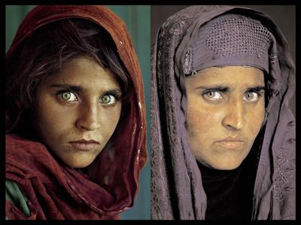
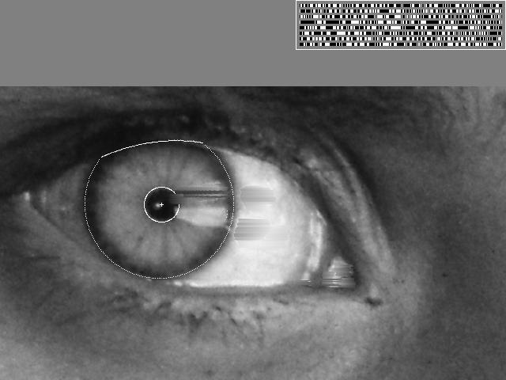
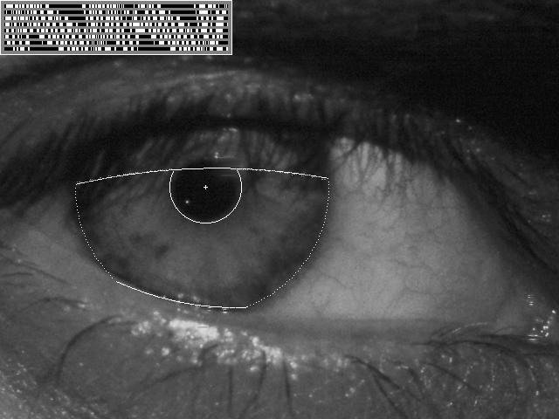
Vision-based biometrics
“How the Afghan Girl was Identified by Her Iris Patterns” Read the story
wikipedia
Notes:
Age 12, Age 30

Slide 25
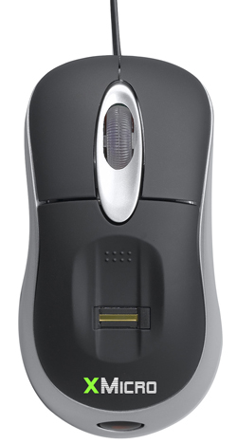
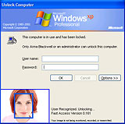
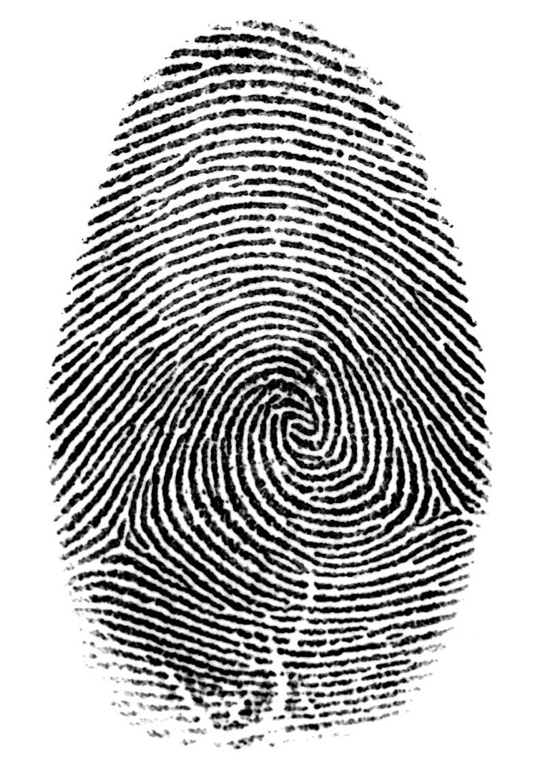

Login without a password…
Fingerprint scanners on many new laptops, other devices
Face recognition systems now beginning to appear more widely http://www.sensiblevision.com/

Slide 26
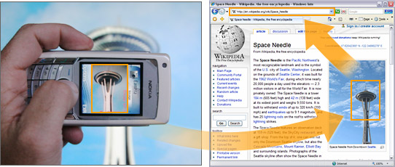
Object recognition (in mobile phones)
Point & Find, Nokia
Google Goggles

Slide 27
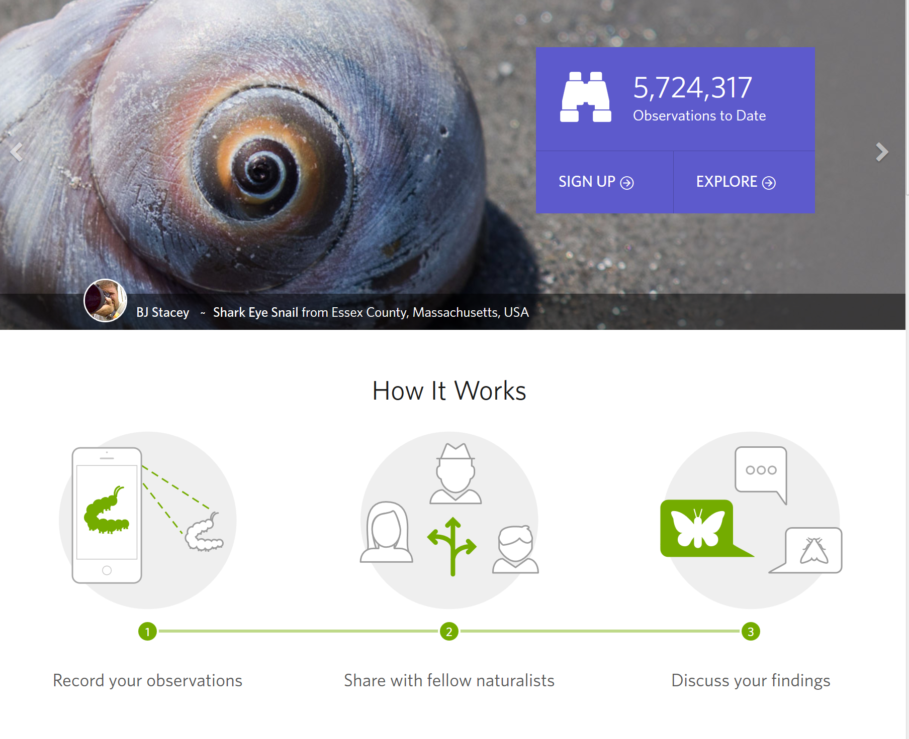
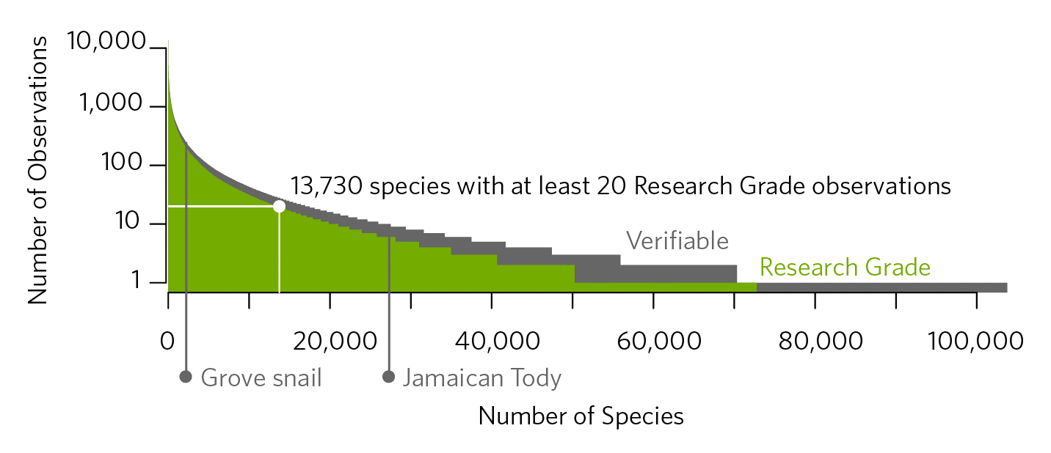
iNaturalist
https://www.inaturalist.org/pages/computer_vision_demo
Notes:
https://www.inaturalist.org/pages/computer_vision_demo

Slide 28
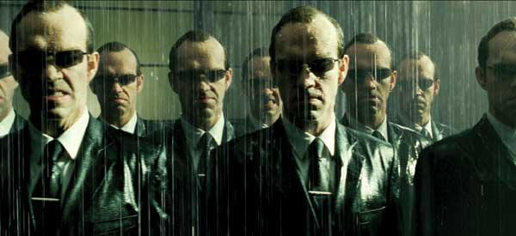
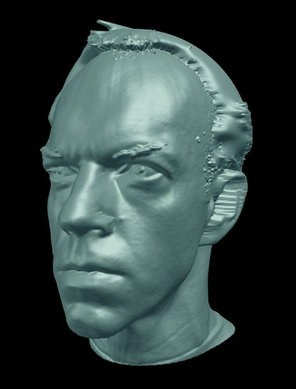
Special effects: shape capture
The Matrix movies, ESC Entertainment, XYZRGB, NRC

Slide 29
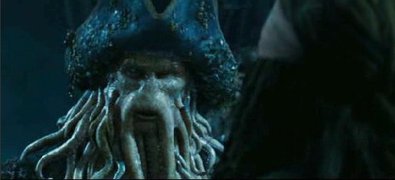
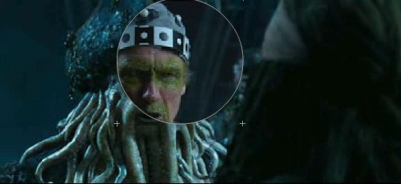
Special effects: motion capture
Pirates of the Carribean, Industrial Light and Magic

Slide 30
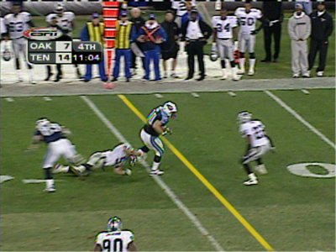
Sports
Sportvision first down line
Nice explanation on www.howstuffworks.com
http://www.sportvision.com/video.html

Slide 31
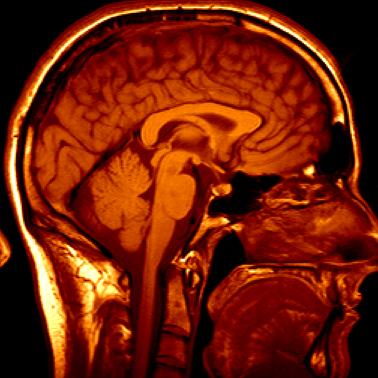
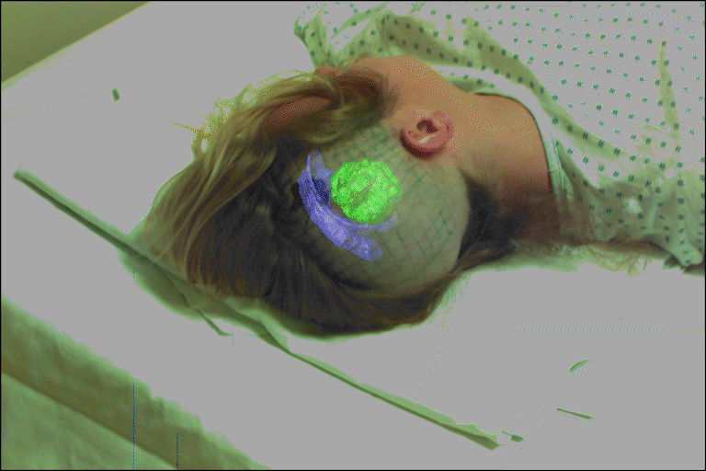
Medical imaging
3D imaging
MRI, CT
Image guided surgery
Grimson et al., MIT

Slide 32
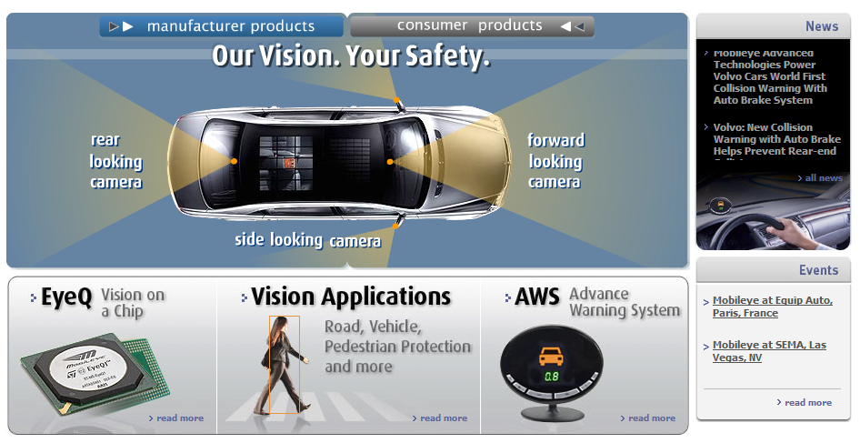
Smart cars
Slide content courtesy of Amnon Shashua
Mobileye
Market Capitalization: 11 Billion dollars
Bought by Intel for 15 Billion dollars

Slide 33
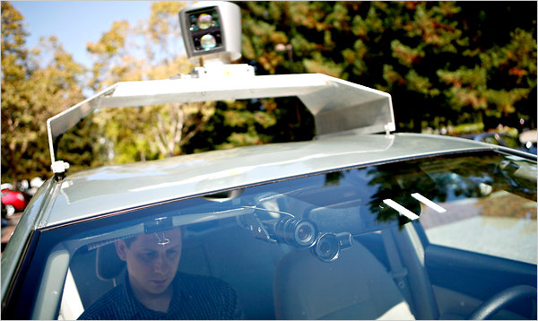
Google cars
Oct 9, 2010. "Google Cars Drive Themselves, in Traffic". The New York Times. John Markoff
June 24, 2011. "Nevada state law paves the way for driverless cars". Financial Post. Christine Dobby
Aug 9, 2011, "Human error blamed after Google's driverless car sparks five-vehicle crash". The Star (Toronto)

Slide 34
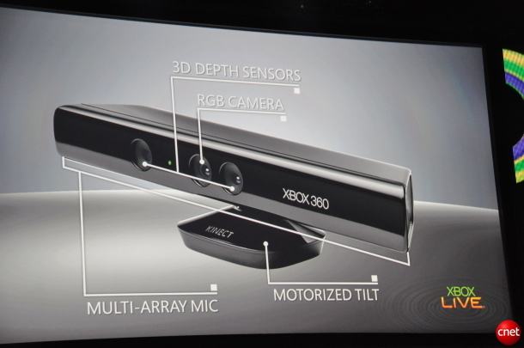
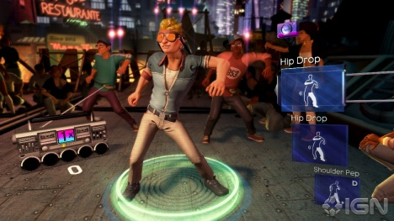
Interactive Games: Kinect
Object Recognition: http://www.youtube.com/watch?feature=iv&v=fQ59dXOo63o
Mario: http://www.youtube.com/watch?v=8CTJL5lUjHg
3D: http://www.youtube.com/watch?v=7QrnwoO1-8A
Robot: http://www.youtube.com/watch?v=w8BmgtMKFbY

Slide 35
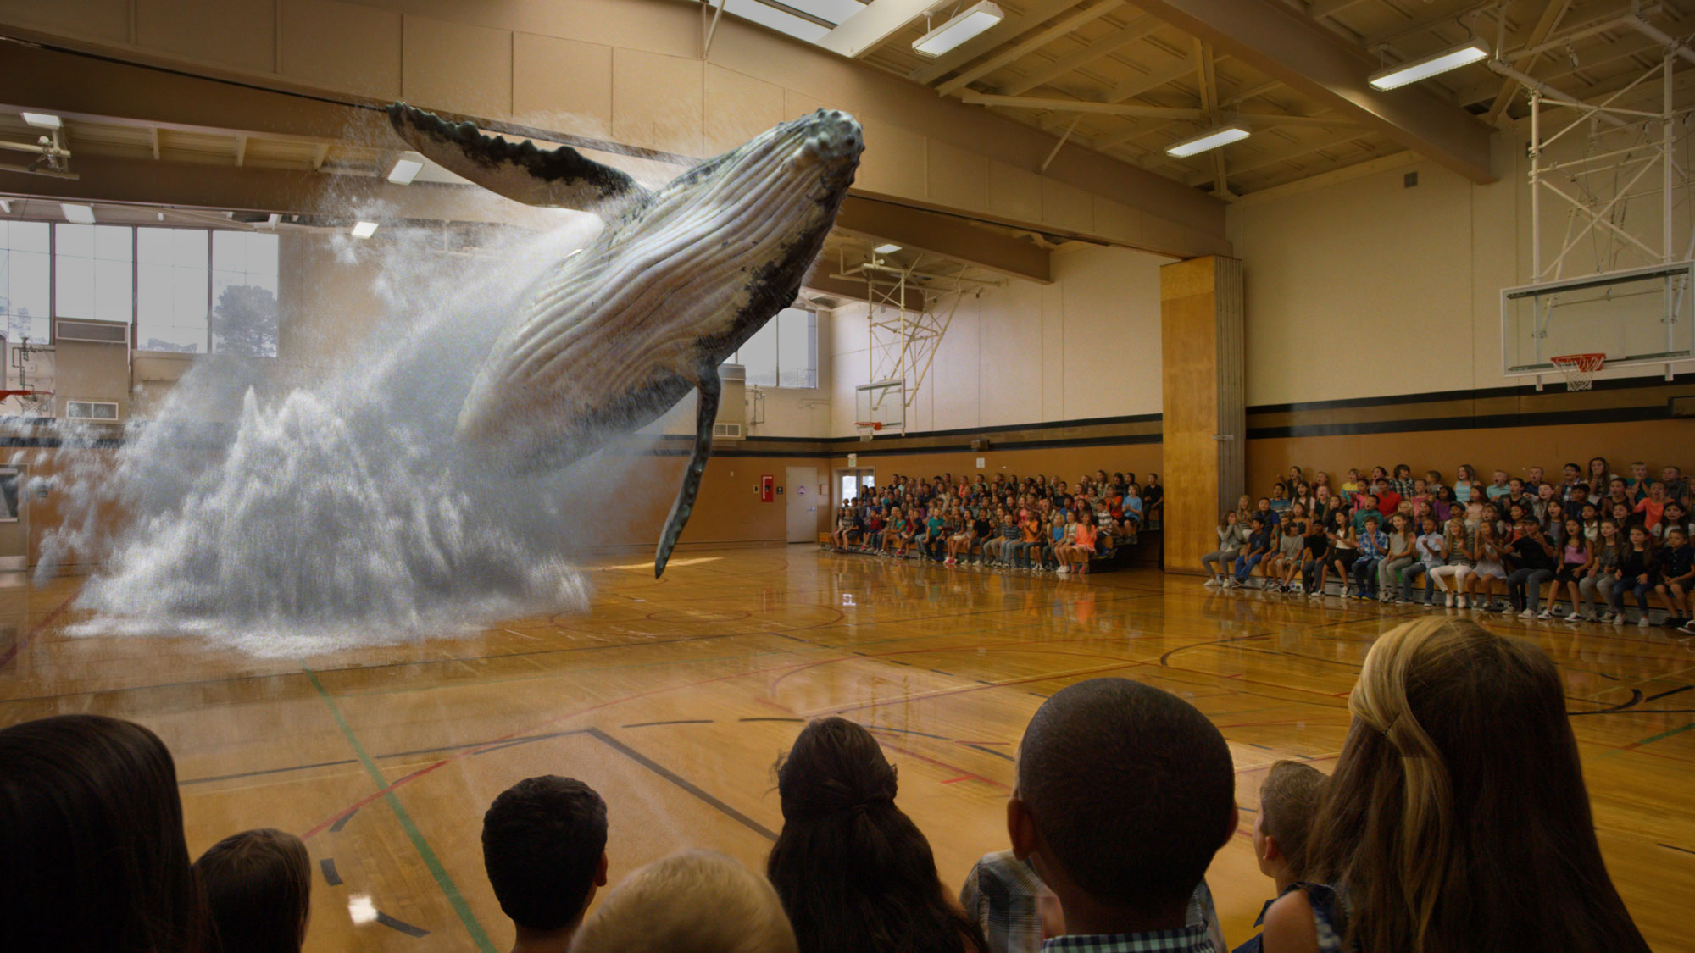
Augmented Reality and Virtual Reality
Magic Leap, Oculus, Hololens, etc.

Slide 36
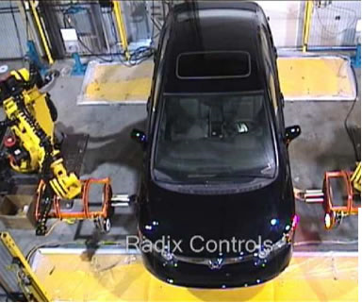
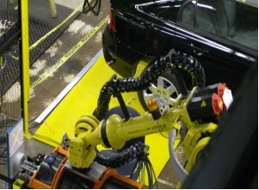
Industrial robots
Vision-guided robots position nut runners on wheels

Slide 37
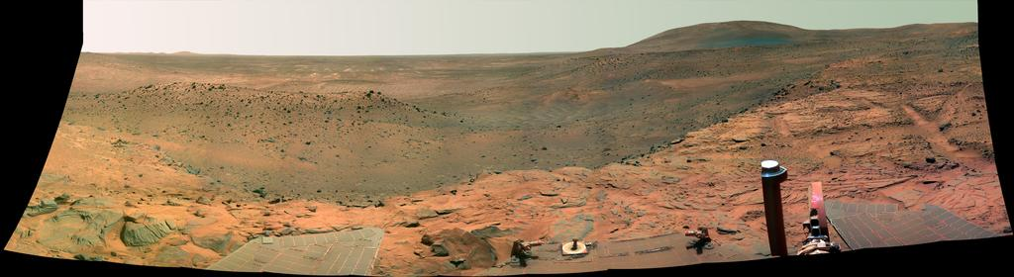
Vision in space
NASA'S Mars Exploration Rover Spirit captured this westward view from atop a low plateau where Spirit spent the closing months of 2007.
Vision systems (JPL) used for several tasks
Panorama stitching
3D terrain modeling
Obstacle detection, position tracking
For more, read “Computer Vision on Mars” by Matthies et al.

Slide 38
Amazon Prime Air
https://www.amazon.com/b?node=8037720011

Slide 39
State of the art today?
With enough training data, computer vision nearly matches human vision at most recognition tasks
Deep learning has been an enormous disruption to the field. More and more techniques are being “deepified”.

Slide 40


Slide 41
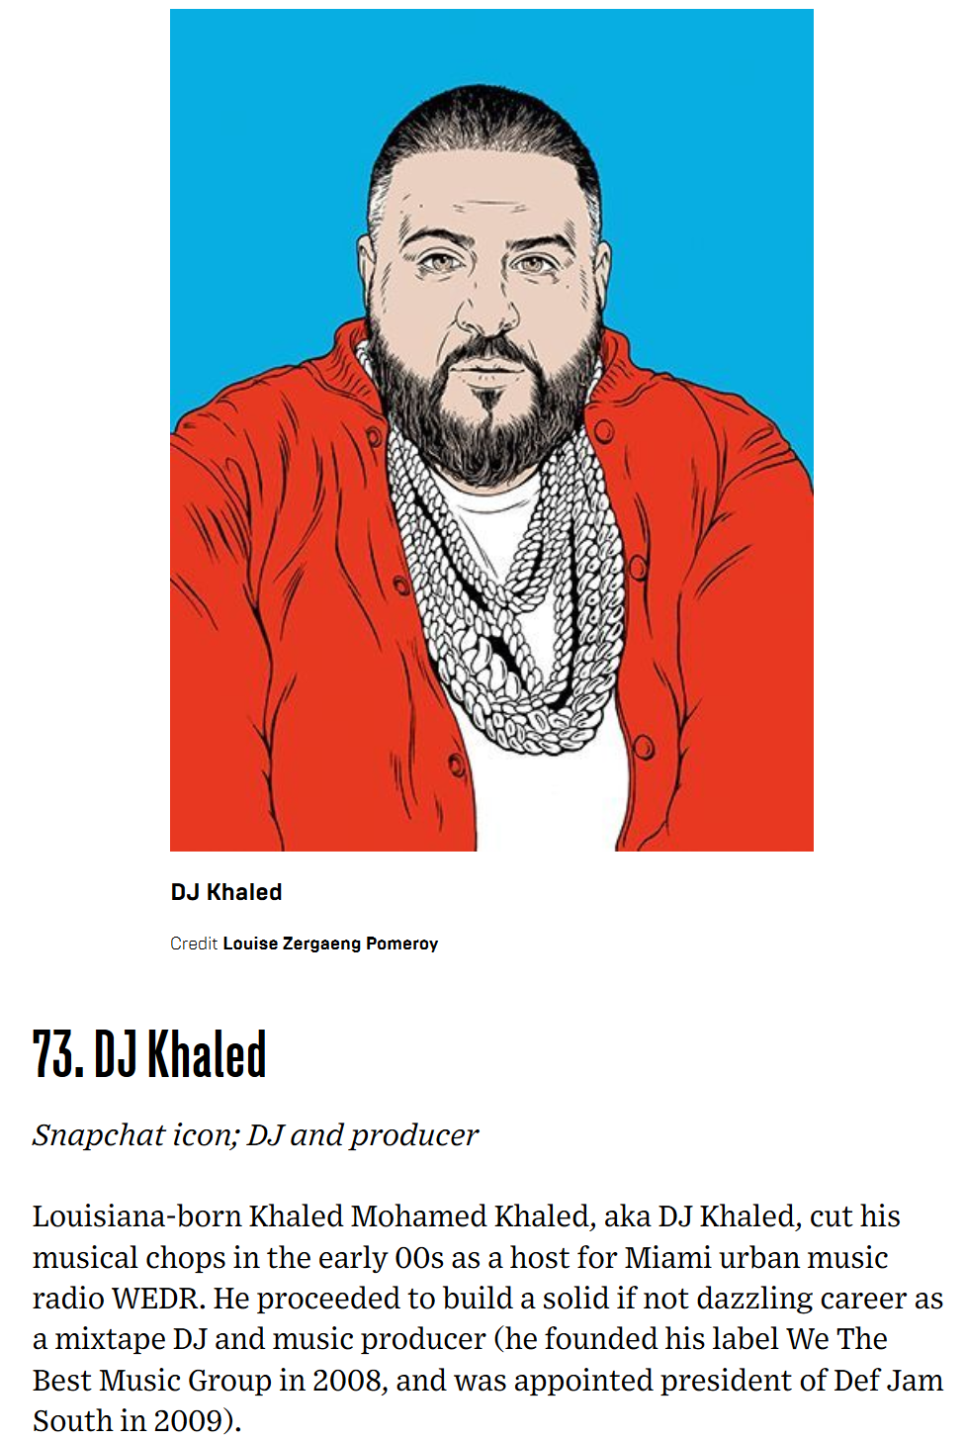

Slide 42
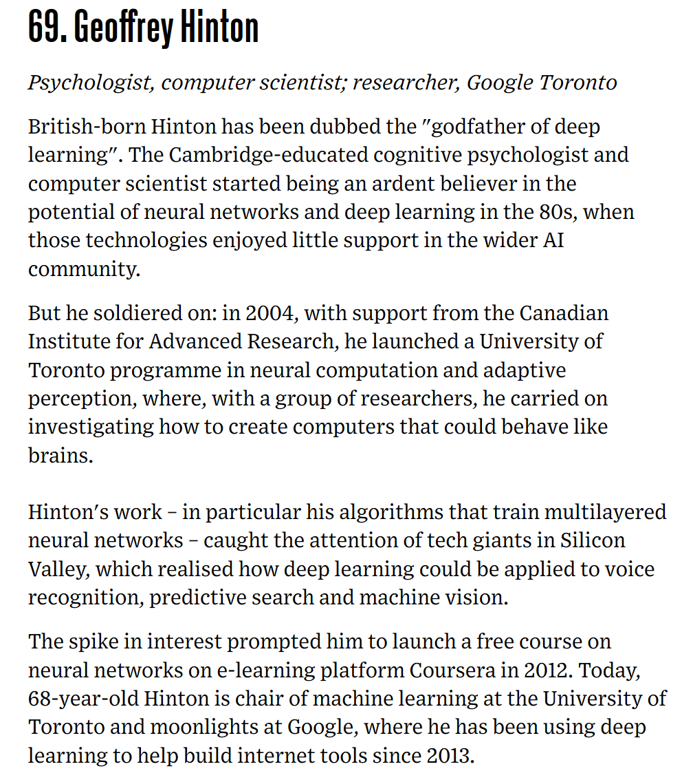

Slide 43
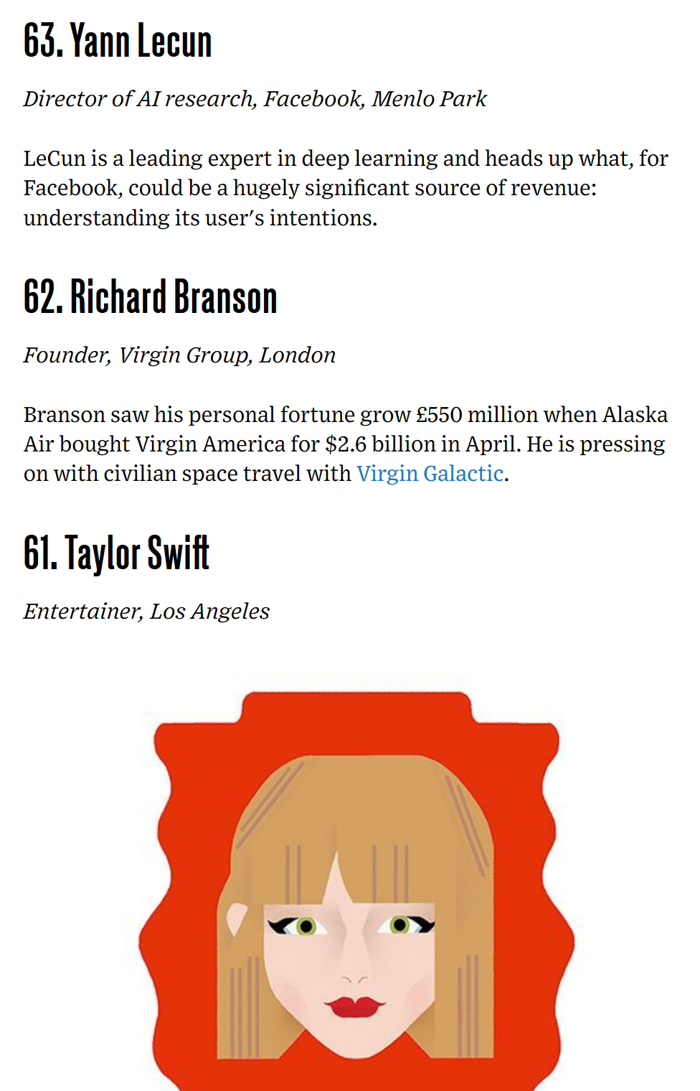

Slide 44
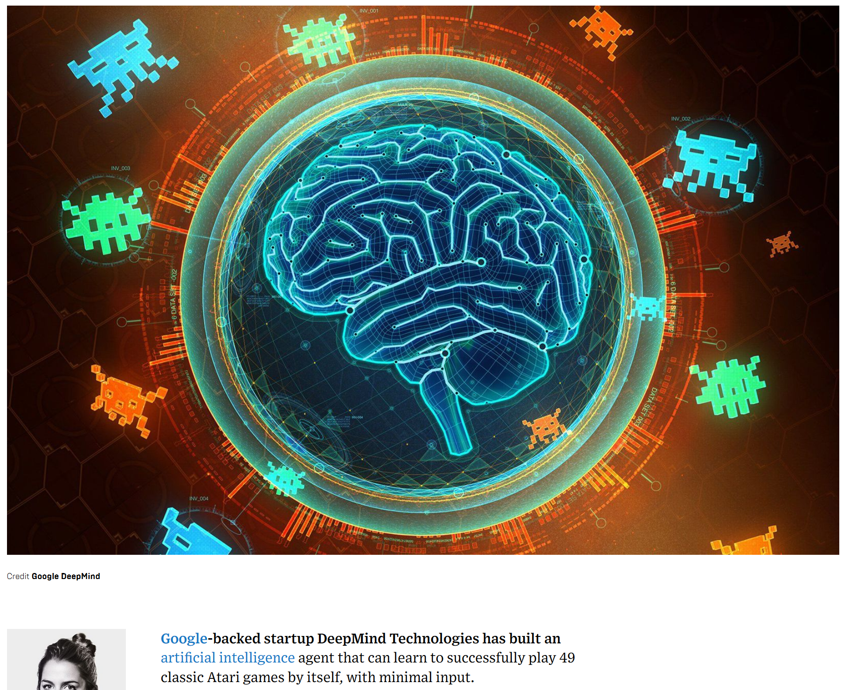

Slide 45
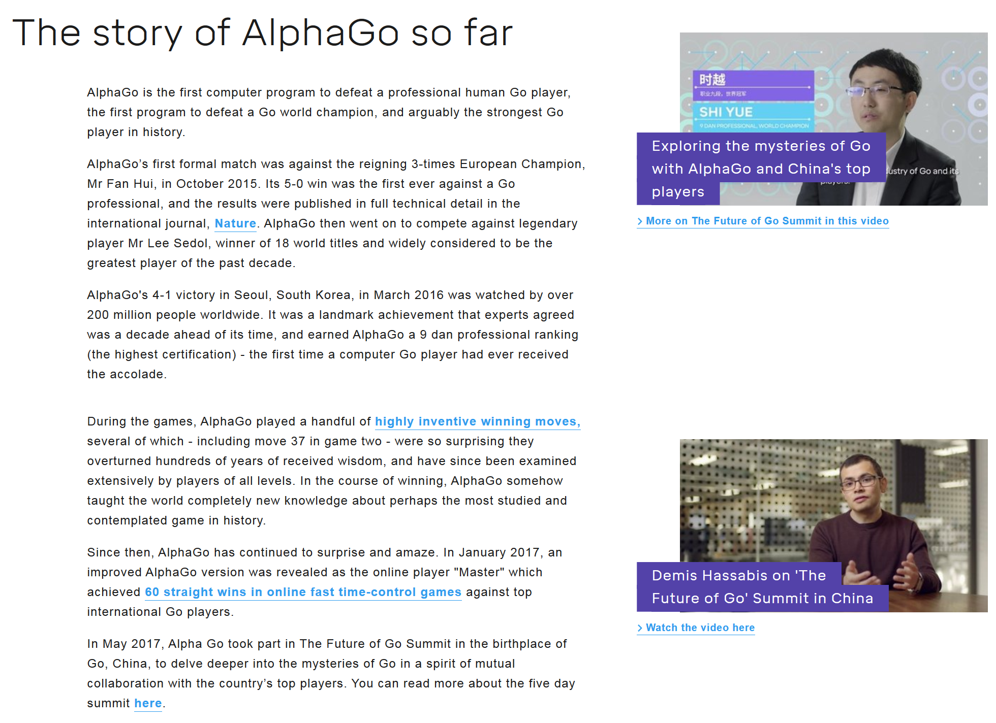

Slide 46
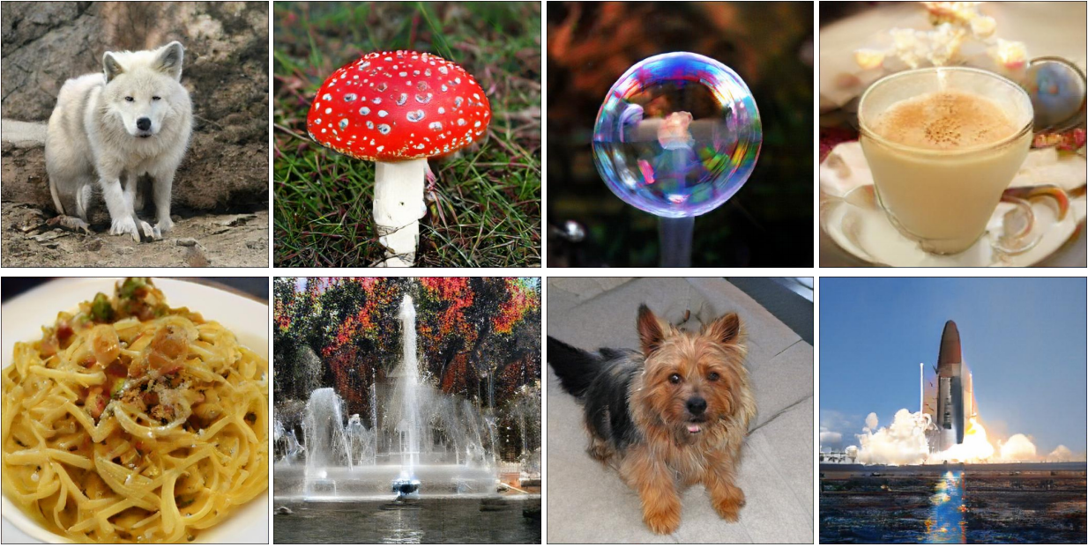
BigGAN
2018 Arxiv, ICLR 2019

Slide 47


This person does not exist
https://www.thispersondoesnotexist.com/

